Slide 1
Yorkshire & the Humber Regional Delivery Officer – (Part-Time) April 2024

Slide 2
Note from the Sported CEO
Thank you for expressing an interest in this important and exciting role as Sported looks to further grow the charity.
It has never been a harder time to be a young person growing up in the UK. One in four children live in poverty; 80% of young people note their mental health has worsened in recent months. With youth provision reduced by over 40% since 2015, an already challenging future has been exacerbated by Covid-19 which has disproportionately affected the most disadvantaged and widened inequalities.
Amidst the gloom, thousands of community sports groups operate, not to create the next sporting superstar, but to remove barriers from young people’s lives to allow them to thrive against the odds. We are the UK’s largest network of community sports groups, and we exist to provide our group leaders with the skills and funding needed so that their groups can become inclusive, sustainable and deliver their services to those who those in need. We are driven to act as a voice of grassroots sport, especially on behalf of those who are minoritised and helping to tackle inequalities at community level.
If successful, you’ll be joining a remarkable Sported team of 50 people with a wide range of backgrounds and specialisms. You will lead an excellent, and ambitious London team and work closely with the other managers within the Delivery Team including the National Managers in England, Scotland, Wales and Northern Ireland. We also have a central office in Borough, London.
Even more capacity is provided by our skilled, knowledgeable and passionate volunteers, who now number more than 300, and who work with the leaders of our member groups – most of them also volunteers – to build the effectiveness and sustainability of their organisations, so that they can do what they do best: positively influence and change the lives of young people.
For more information about Sported, our services and our impact, please see www.sported.org.uk
Whether or not you apply for this role, I’m grateful to you for considering bringing your skills and energy to Sported and our wonderful members.
Yours faithfully,
Sarah Kaye
Sported CEO

Slide 3
Reach. Include. Empower
Our vision
We want every young person to have the same opportunity to fulfil their potential.
We know sport and physical activity can have wide ranging benefits for young people, communities, and society.
Between 2021 and 2025, we have identified 3 priority areas - wellbeing, equality and community - that are hugely relevant and important within the current environment, and also where we believe Sported has the expertise and experience to have the biggest impact.
At the heart of our work will remain our long-standing commitment to support the passionate, dedicated local people who are running vital community sports groups across the UK and building the resilience of these groups, so that they can survive and thrive.
Our 2021-25 organisational strategy, sets out how we will strengthen the local workforce and build the resilience of community sports groups.
Through our network of 3,000 grassroots groups, we will improve wellbeing, tackle inequalities and connect communities.
Our purpose
Helping community groups survive, to help young people thrive.

Slide 4
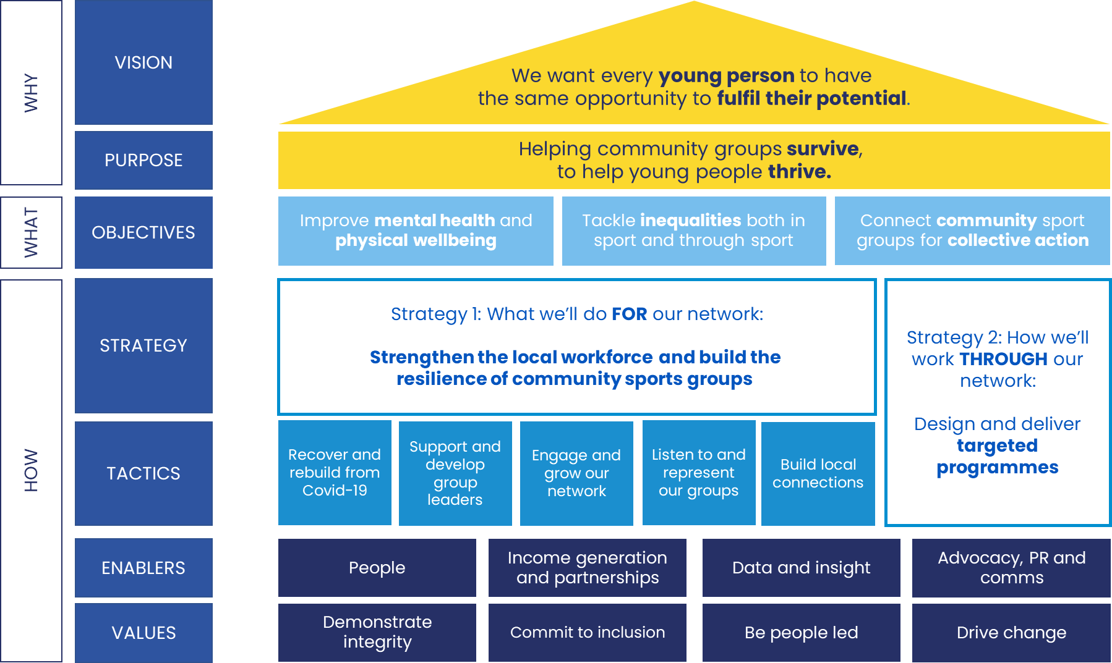
The Clubhouse
Sported’s Organisational Strategy – Reach, Include, Empower 2021-2025
Girls had a more positive perception of themselves, including feeling less of a failure and being happy with who they are

Slide 5
Staff benefits
Flexible working arrangements, including working from home and flexibility around caring responsibilities
A confidential counselling service is available to all employees free of charge
Annual leave entitlement of 25 days, in addition to public holidays (pro-rata for part-time colleagues) increasing 1 day per year after 4 years
Access to a Pension Scheme to give you peace of mind
A Sported ‘Culture Club’ made up of six members of staff, who come together to discuss Sported staff culture, issues and promote innovation
‘Learning Lunch’, a timetable of in-house virtual training sessions where staff learn from each other on a variety of subjects related to our work
At Sported, the wellbeing of our staff is paramount, we are proud to offer benefits to promote a happy and healthy team
2 x ‘personal leave’ days for religious holidays and/or wellbeing days
2 x ‘volunteer’ days to volunteer for another charity or Sported members
Up to 5 x ‘study leave’ for
self-funded education/ training
Virtual
Diversity & Inclusion
‘Open Spaces’
Every month where the team support each other and raise awareness on topics such as Race equity, LGBTQ+ inclusion and Disability awareness.

Slide 6
Our values
Demonstrate integrity
Commit to inclusion
Be people led
Drive change
We lead by example
We are honest, open and trustworthy
We are diligent and committed
We are willing to challenge and be challenged
We are positive, supportive, and approachable
We value an inclusive culture
We demonstrate respect and equality for all
We are innovative and make things happen
We strive for continuous improvement professionally and personally
We make a significant impact to communities and young people
We are led by the needs of our network and volunteers
We invite feedback and respond quickly
We collaborate and support our colleagues

Slide 7
Role overview and responsibilities

Slide 8
Job title: Yorkshire & the Humber Regional Delivery Officer
Reporting into: Yorkshire & the Humber Regional Manager
Hours: 22.5 hours – 3 days a week equivalent (Part Time )
Contract: Permanent
Salary: £26,500 - £28,000 (Pro-rata)
Location: Home based within a commutable distance to the Yorkshire & the Humber . Must be willing to travel to meetings when required.
Annual Leave: 25 days (Pro-rata) - in addition to statutory bank holidays
Role overview
This is an exciting time to join Sported as our Yorkshire & the Humber Regional Delivery Officer. You’d be part of an organisation delivering vital services for community groups and young people - knowing that our support is a genuine lifeline for small grassroots groups and the young people they support.
As a key point of contact for our network in Yorkshire & the Humber you will ensure our members are appropriately engaged and supported with a range of services and benefits, including direct support from our pool of volunteer consultants. You will support and develop key partnerships within the region and deliver specific projects according to regional and organisational priorities.
You will be joining a diverse team of exceptional people from across the UK, all with an enviable purpose and drive to deliver the best service to our network of groups, volunteers and partners.
Internal relationships:
Yorkshire & the Humber Regional Manager
England National Manager
National Teams
Delivery Team incl. Volunteer Services
Marketing & Communications incl. Member Services team
Insight & Strategy
Strategic Leadership Team
Sported Volunteer consultants
External relationships:
Sported Members
Sported Volunteer Consultants
Regional partner organisations
Community sports providers
Local government
Voluntary Sector including youth sector
Funders
Local Media

Slide 9
Role responsibilities
Membership Engagement & Growth
In conjunction with the Yorkshire & the Humber Regional Manager deliver a clear strategy for member engagement, support and recruitment in your region in support of organisational KPIs and Projects​.
Be the primary point of contact for Sported members within your region and support them with their own capacity building /organisational development.
Promote Sported membership and services to non-members, and process new member application and conduct onboarding calls.
Support content creation for member communications, including utilisation of relevant social media platforms, channels and other alternative communication methods.
Build strong relationships with the Sported membership, identifying areas of need and trends from the Yorkshire & the Humber network.
Promote and engage members with our services and benefits, ensuring they are aware of how to access the Sported Hub​.
Provide support to members on elements of capacity building – e.g. fundraising, strategic planning, health checks & sustainability.
Support Sported members with completion of relevant monitoring and evaluation in conjunction with the support they have received​.
Maintain accurate records in our central database and other systems.
Work in partnership with the rest of the Delivery Team to share best practice and implement partnership ideas/opportunities where appropriate​
Delivery and Projects
To support the delivery of current and future member projects within the Region, including the development and delivery of necessary support, and the deployment of volunteer consultants where necessary.
Support the development of new project ideas within Yorkshire & the Humber, identifying areas of member need or areas of focus.
Maintain accurate project administration, including project measurement, evaluation and feedback as required to achieve agreed project outcomes.

Slide 10
Role responsibilities
Volunteer Engagement
Working closely with the Yorkshire & the Humber Regional Manager deploy the volunteer team across the region to support member groups.
Support the recruitment of volunteers across the region in line with the specific requirements for the region and in line with organisational priorities.
Working closely with the Volunteer Services Team to ensure all necessary volunteer processes, including documentation, capturing impact of support are adhered to.
Support the delivery of the Sported Volunteer programme delivering regional networking events, facilitate and support the development of volunteers.
General Administration (and other responsibilities):
Support the Regional Manager in the administration of Sported operations across the region.
Ensure data on your regions’ members and volunteers is kept accurate and up to date​
General involvement with other Sported events as required such as national team meetings (approx. one every 3 months).

Slide 11
Person specification

Slide 12
Knowledge and experience
Essential Experience
An understanding of the voluntary/community sports sector.
An understanding of the needs of groups and organisations offering community sport to disadvantaged young people.
Experience of working with partner organisations and stakeholders to deliver projects and programmes.
An understanding of the policies and procedures required to support grant applications.
Experience of working in a client facing or membership support role. ​
Clear demonstrable experience of a confident telephone manner when speaking to members and stakeholders.
Clear demonstrable experience of administering or delivering programmes / projects to a high standard. ​
Demonstrable experience of working in a skilled administration role, with excellent understanding of skills required to deliver high level admin support, ideally in a relevant sector.
Experience of database management, ensuring confident use of digital systems. ​
Ability to research and review information and identify solutions and propose ideas relating to key areas of the work.​
Ability to always maintain a high level of confidentiality and discretion.​
Desirable experience
Experience of recruiting and managing volunteers.
Experience collecting information to monitor and evaluate impact.
Experience of delivering training and facilitation.
Experience of remote working.
Personal qualities
Committed to Sported’s aims and objectives.
Be able to demonstrate your willingness and ability to travel across the Yorkshire & the Humber region and occasionally across England as required, sometimes out of office hours.
Suitable set-up to work from home – (Laptop/Phone provided by Sported).

Slide 13
Skills
Member Engagement & Support
Skill in executing a clear strategy for engagement, recruitment and support.
Excellent written and verbal communication skills
Knowledge of capacity building practices – incl. fundraising, strategic planning and organisational development.
Strong analytical, critical thinking and problem-solving skills to provide solutions and advice to member groups.
Volunteer Engagement & Support
Collaborative skills to work with volunteer consultants, the volunteer services team and other colleagues to ensure the effective use of volunteers to meet member needs.
Project Delivery
Strong project delivery skills and experience to support the delivery of current and future projects
Proficiency in providing guidance and support on various projects
Proficiency in delivery of workshops and webinars.
Ability to evaluate and measure impact and make data-driven decisions.
Administration & General Responsibilities
Strong organisational skills to ensure accurate and up-to-date data management
Proficiency in CRM database systems and Microsoft Suite
Proficiency in presenting information clearly and persuasively to internal and diverse stakeholders.
Other Skills
Critical thinking skills to analyse challenges and develop effective solutions.
Excellent teamwork and collaborative skills with internal and external colleagues and partners.
Resilience in managing multiple responsibilities and deadlines in a dynamic environment.

Slide 14
We actively encourage applicants from diverse backgrounds especially from ethnically diverse, LGBTQ+ and disabled communities as well as those with lived experiences of tackling inequalities, as we believe diverse voices are instrumental in creating transformational change.
Recruitment timeline:
Closing date for applications: Sunday 28 April 2024 at 11.59pm
Notify successful applicants: 7 May 2024
Interviews: 13/ 14/ 15 May 2024
Role commences: June – July 2024
To apply for this role please head to the career page on our website, where you will find a link to apply. You are required to upload your CV and supporting statement providing clear examples of how you meet the person specification, ideally including a work portfolio. You should also complete our Equality and Diversity Monitoring form.
Please note: Only successful applicants invited to interview will be contacted. Please assume therefore that if you have not heard from us, you have not been successful for interview.
If you would like to have
an informal discussion about the role, please contact:
P.Steele@sported.org.uk

